Slide 1
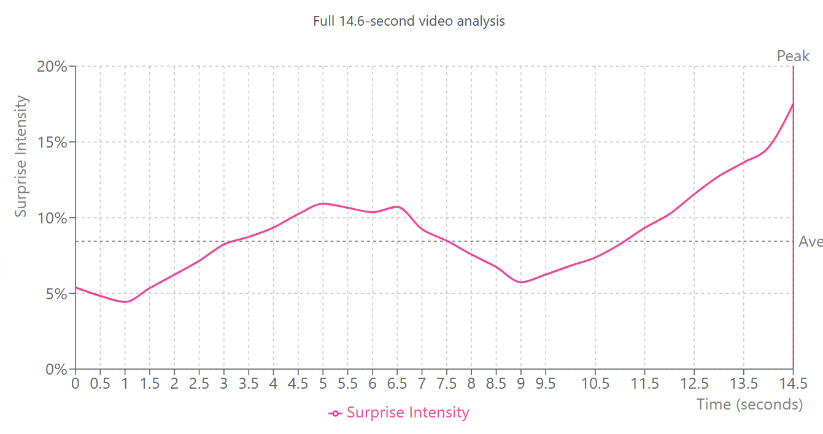
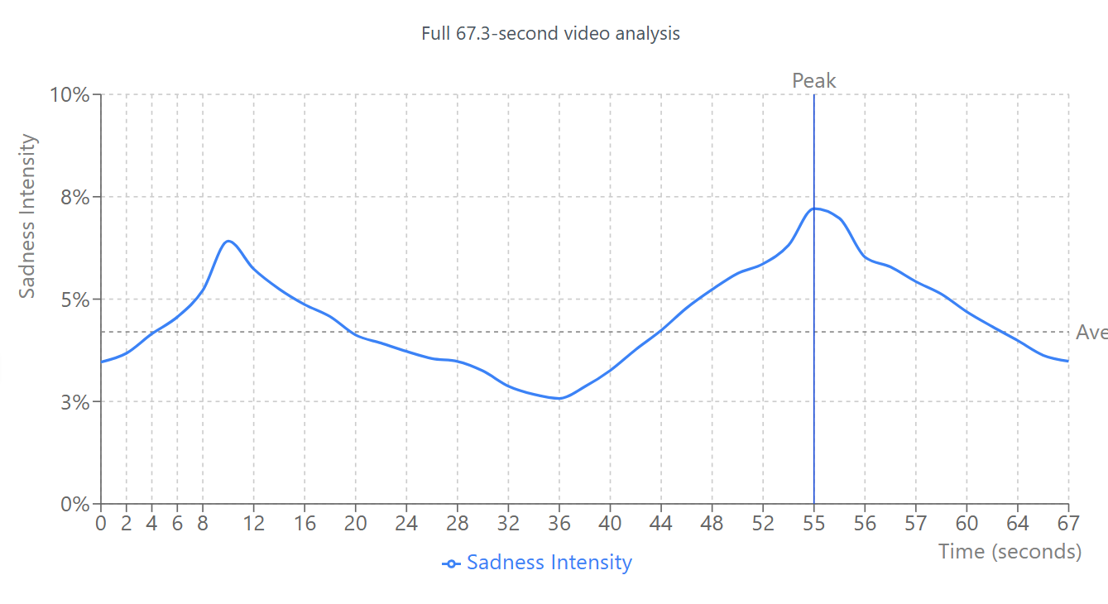
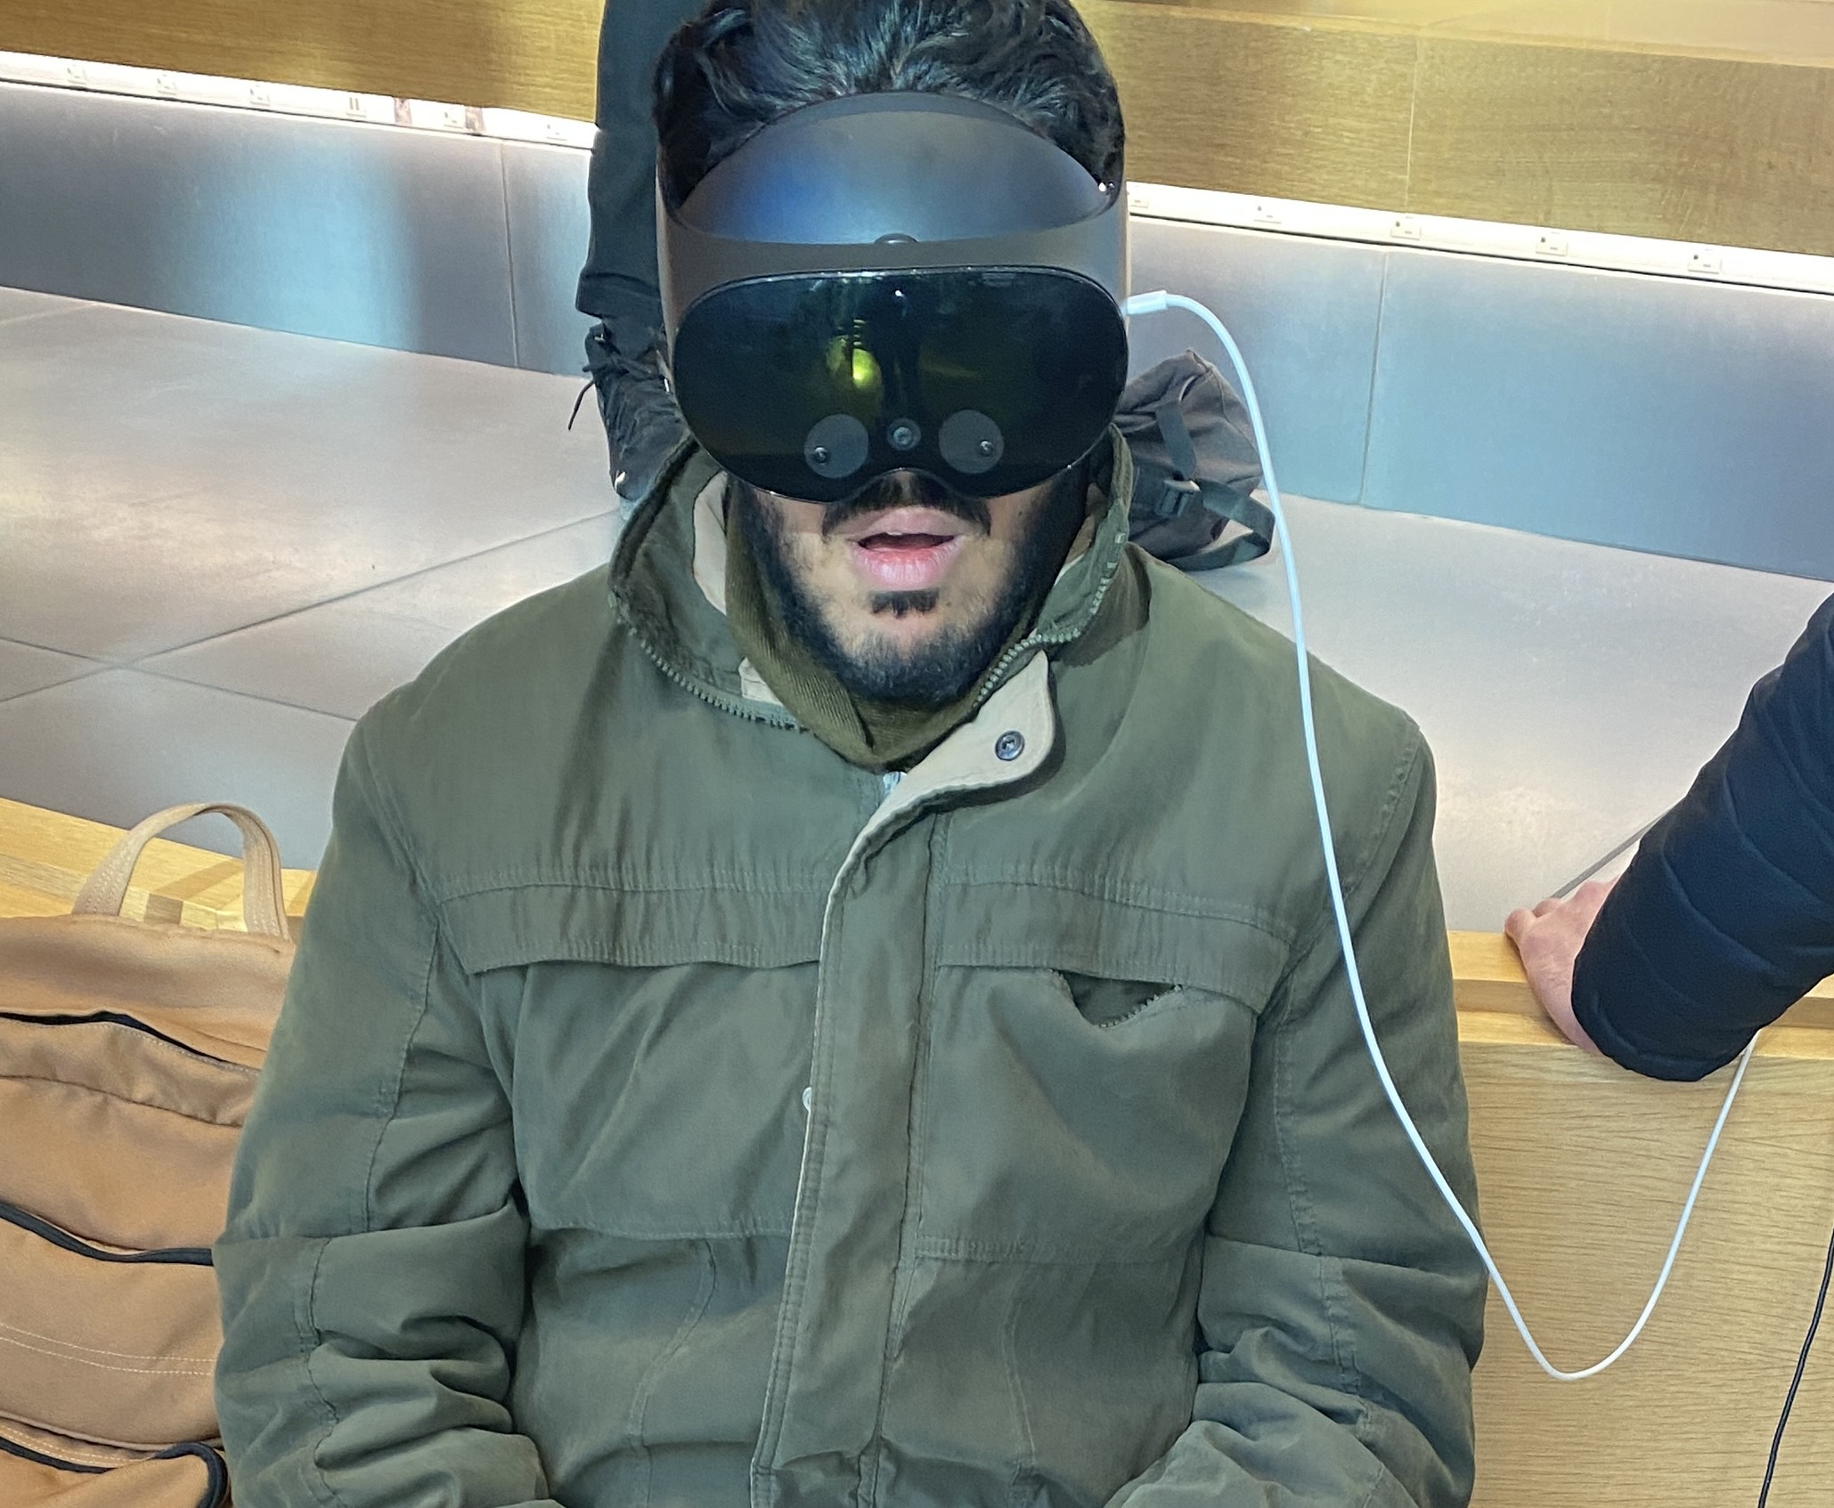
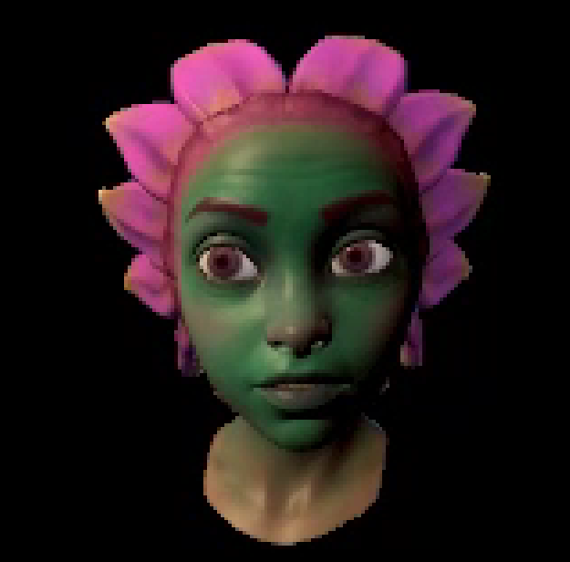
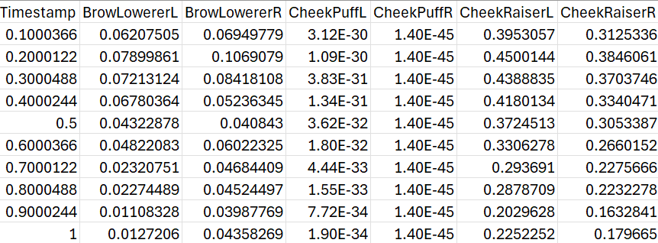
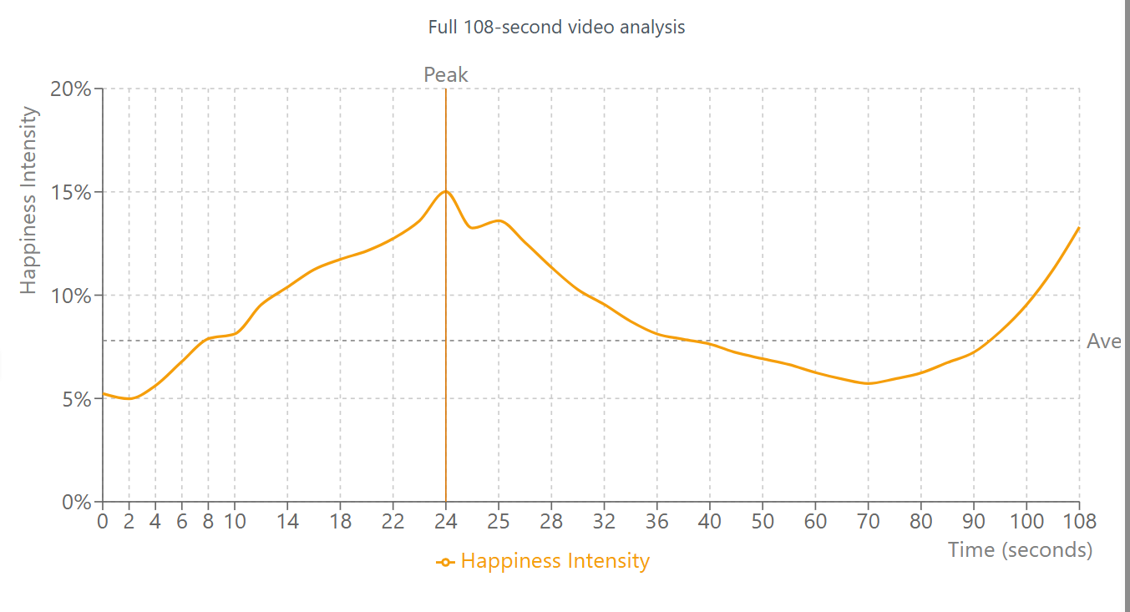
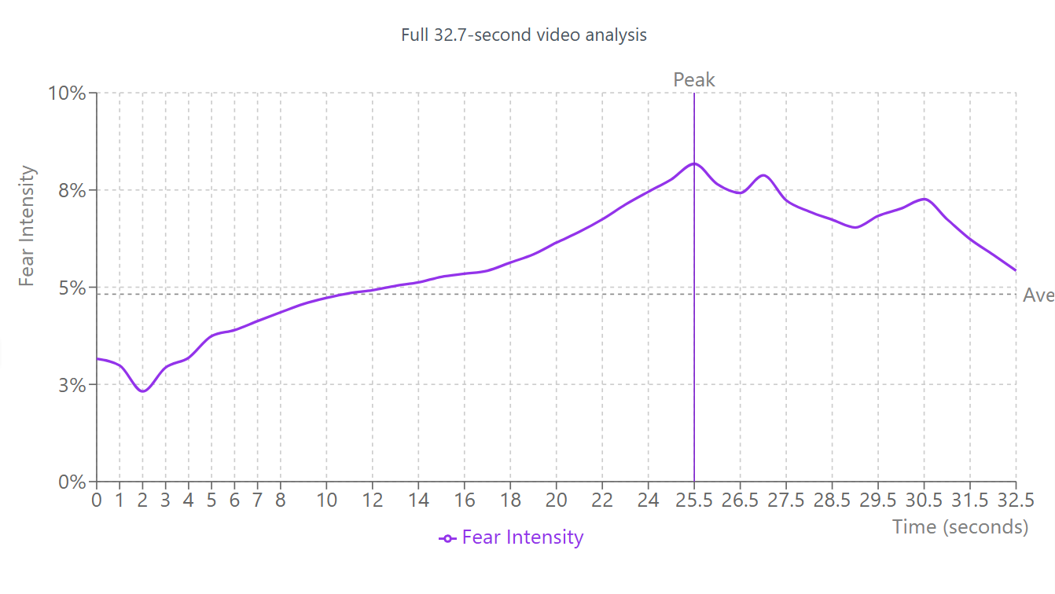
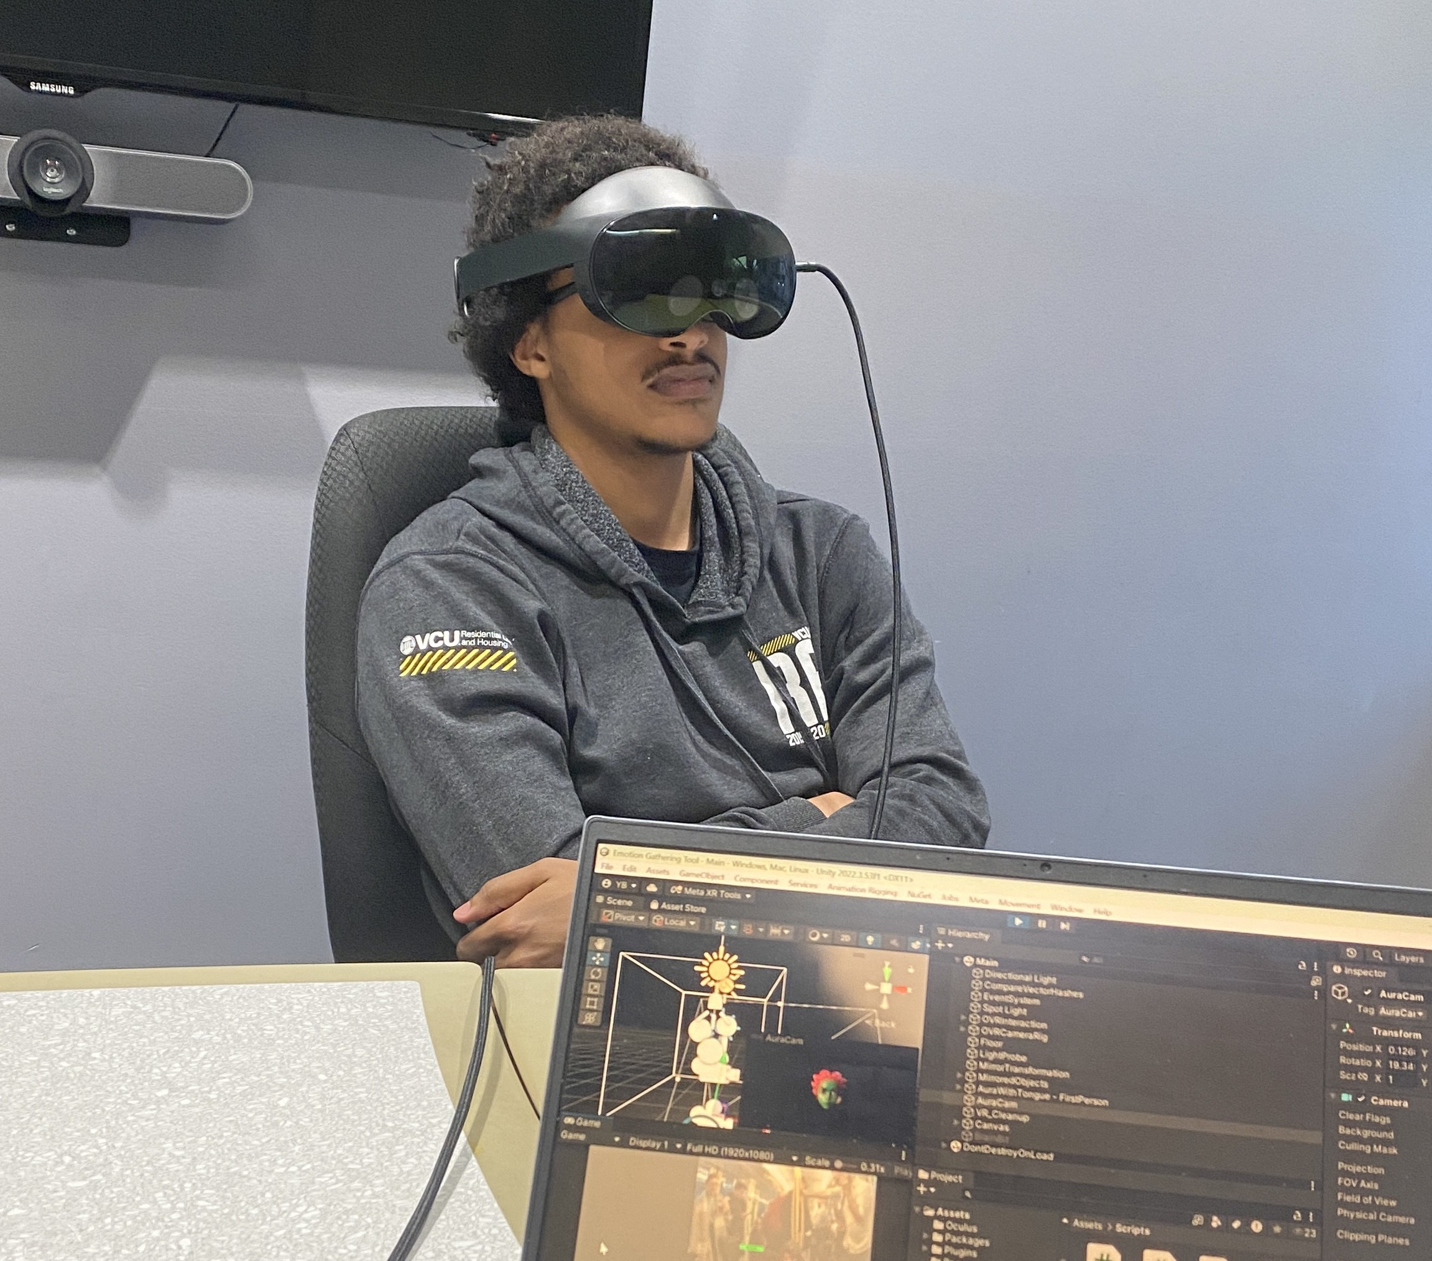
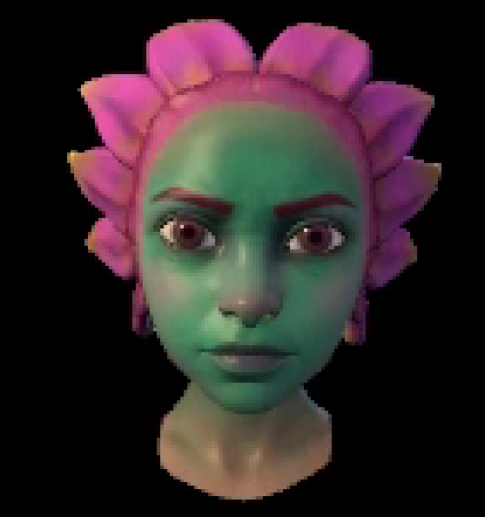
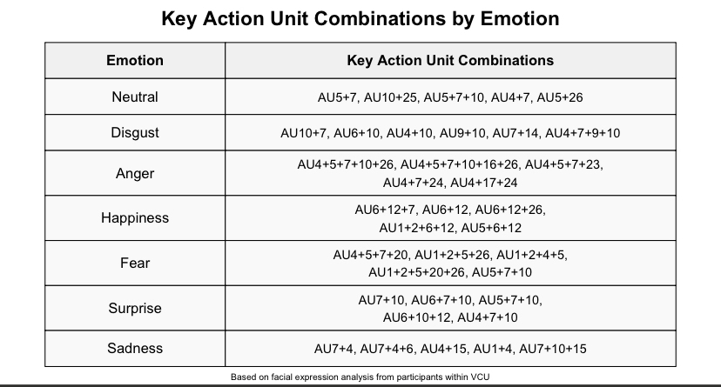
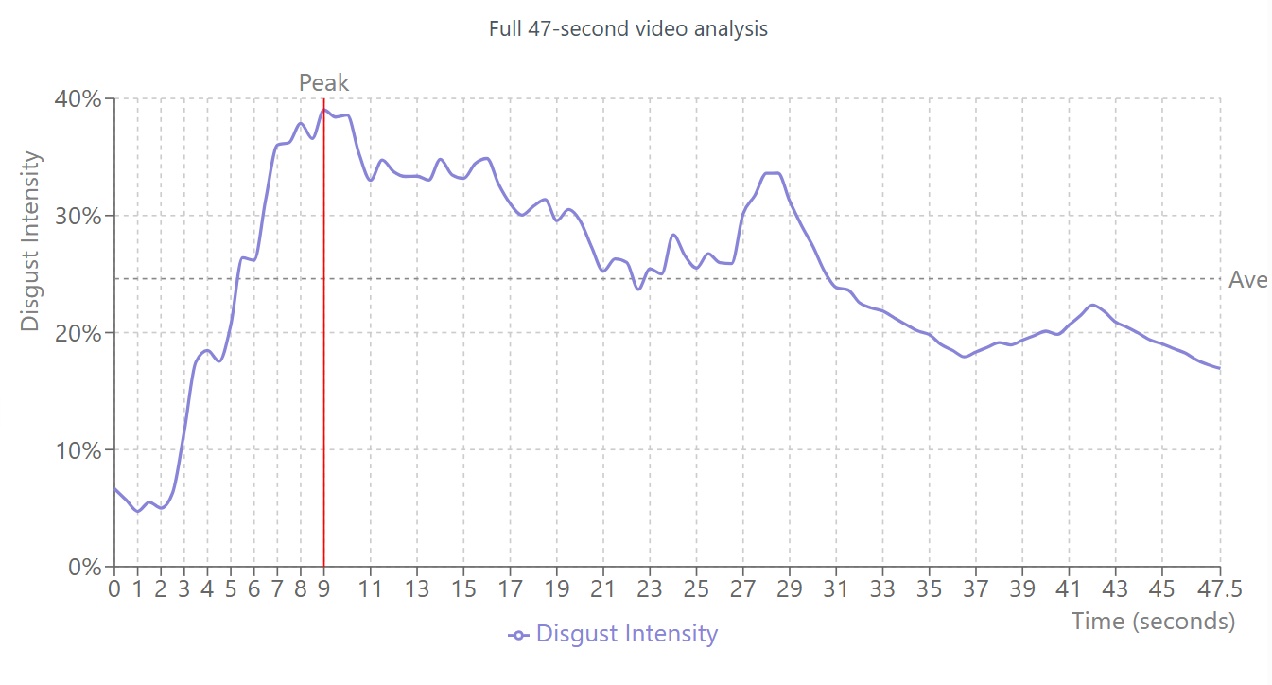
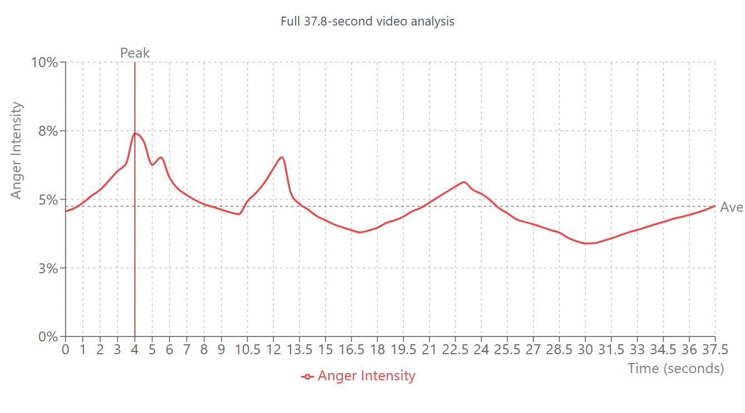
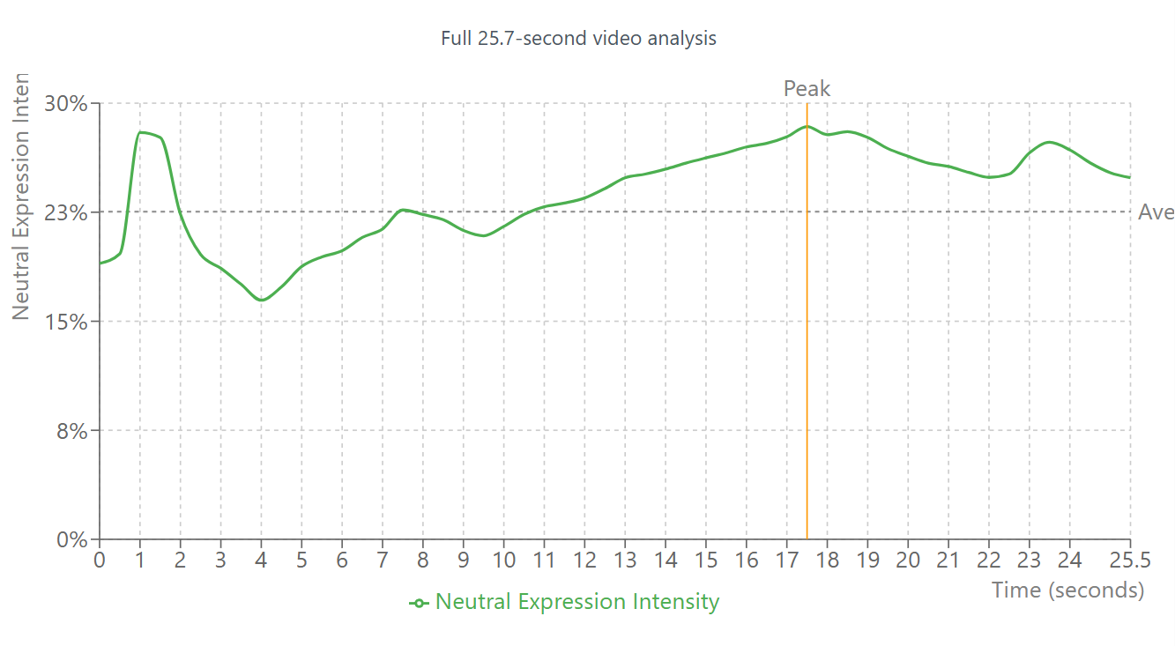
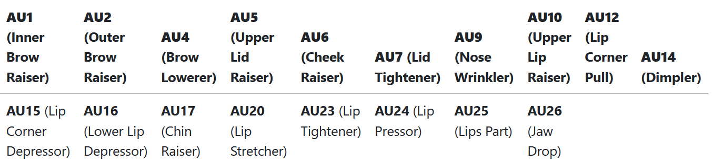
25-315
Emotion Recognition in VR
Team members: Natalia Tondi, Zanika Hossain, Philip Leake, Aryan Rathi, Youssef Bahloul | Faculty adviser: Kostadin Damevski Ph.D. | Sponsor: VCU College of Engineering | Mentors: Rahat Rahman, Terens Tare
Motivation
To study the complexity of emotions in human facial expressions, we created a software tool and a protocol for gathering “emotion data” from users to create a dataset of emotions. Not all facial expressions are created equal; however, and sometimes someone can be faking. To detect this, we trained our emotion recognition AI model on both “fake” and “genuine” emotion data we collected.
Intense Feelings
Participants in our study watched seven different videos, each corresponding to one of seven basic emotions. We analyzed the weight of specific facial action units corresponding to each emotion and determine the intensity of those emotions throughout the duration of their related videos.
Gathering Emotions
Action Units
To create our dataset of emotions, we recruited students from VCU to watch videos in VR while recording their avatars’ facial expressions and weights.
Each emotion is linked to a set of facial muscle movements. These are called action units. When one of these muscle movements happens, the weight (a number between 0 and 1) of that action unit is greater.

